Slide 1

Government College of Engineering Karad
(An Autonomous Institute of Government of Maharashtra)
Information Technology Department
Final Year B. Tech. [SEM VII]
Seminar Title: Heart Disease Risk Assessment
with Agentic AI .
Student Name & Roll No. : 1) Maaz Parvez Ansari (22141268)
2) Digvijay Lalaso Salunkhe (22141270)
3) Vishwajit Balaso Gholave (22141239)
4) Shubham Vasant Kambale(22141213)

Slide 2
Problem Statement Background & Motivation
PROBLEM STATEMENT :
Stroke is a leading cause of disability and death worldwide.
Early detection is critical to reduce risk and improve patient outcomes.
Many people lack access to timely and accurate stroke risk assessment.
Traditional diagnostic methods are time-consuming, costly, and require medical expertise.
MOTIVATION :
Heart disease is one of the leading causes of death worldwide.
Many patients remain undiagnosed until the disease reaches a critical stage.
Traditional diagnostic methods are costly, time-consuming, and not always accessible.
There is a need for an affordable and efficient system for early prediction of heart disease.

Slide 3
Introduction :
Heart disease is one of the leading causes of death globally.
Early detection through AI helps save lives.
Traditional ML models need human supervision.
Agentic AI enables autonomous and adaptive intelligence.
This project predicts, explains, and learns from patient data.

Slide 4
Objectives of Proposed Work
PROJECT OBJECTIVES :
Analyze patient-related attributes that influence heart health.
Build an AI-powered system for accurate heart disease prediction.
Provide interpretable and user-friendly results.
Continuously learn and adapt from new data and feedback.
Support preventive care and reduce mortality rates through timely medical
intervention.

Slide 5
Methodology
1. Data Collection
Collect patient data: age, BP, cholesterol, heart rate, etc.
2. Data Preprocessing
Handle missing values, encode categorical data, normalize features, split dataset.
3. Feature Selection
Identify important attributes influencing heart disease.
4.Model Development:
Machine learning algorithms like Logistic Regression, Decision Tree, Random Forest, and SVM.
5. Agentic AI Integration:
The AI acts as a virtual health advisor. It interprets results, explains the risk level, and gives personalized
recommendations such as quitting smoking, improving diet, exercising regularly, and managing
stress.
6. Prediction & Analysis
Input new patient data → Predict risk of heart disease → Visualize results.

Slide 6
What is Agentic AI?
• Agentic AI = AI with agency (plans, reasons, and acts).
• Works through multiple cooperating agents.
• Each agent performs specific tasks collaboratively.
• 5-Agent structure ensures end-to-end autonomy.

Slide 7
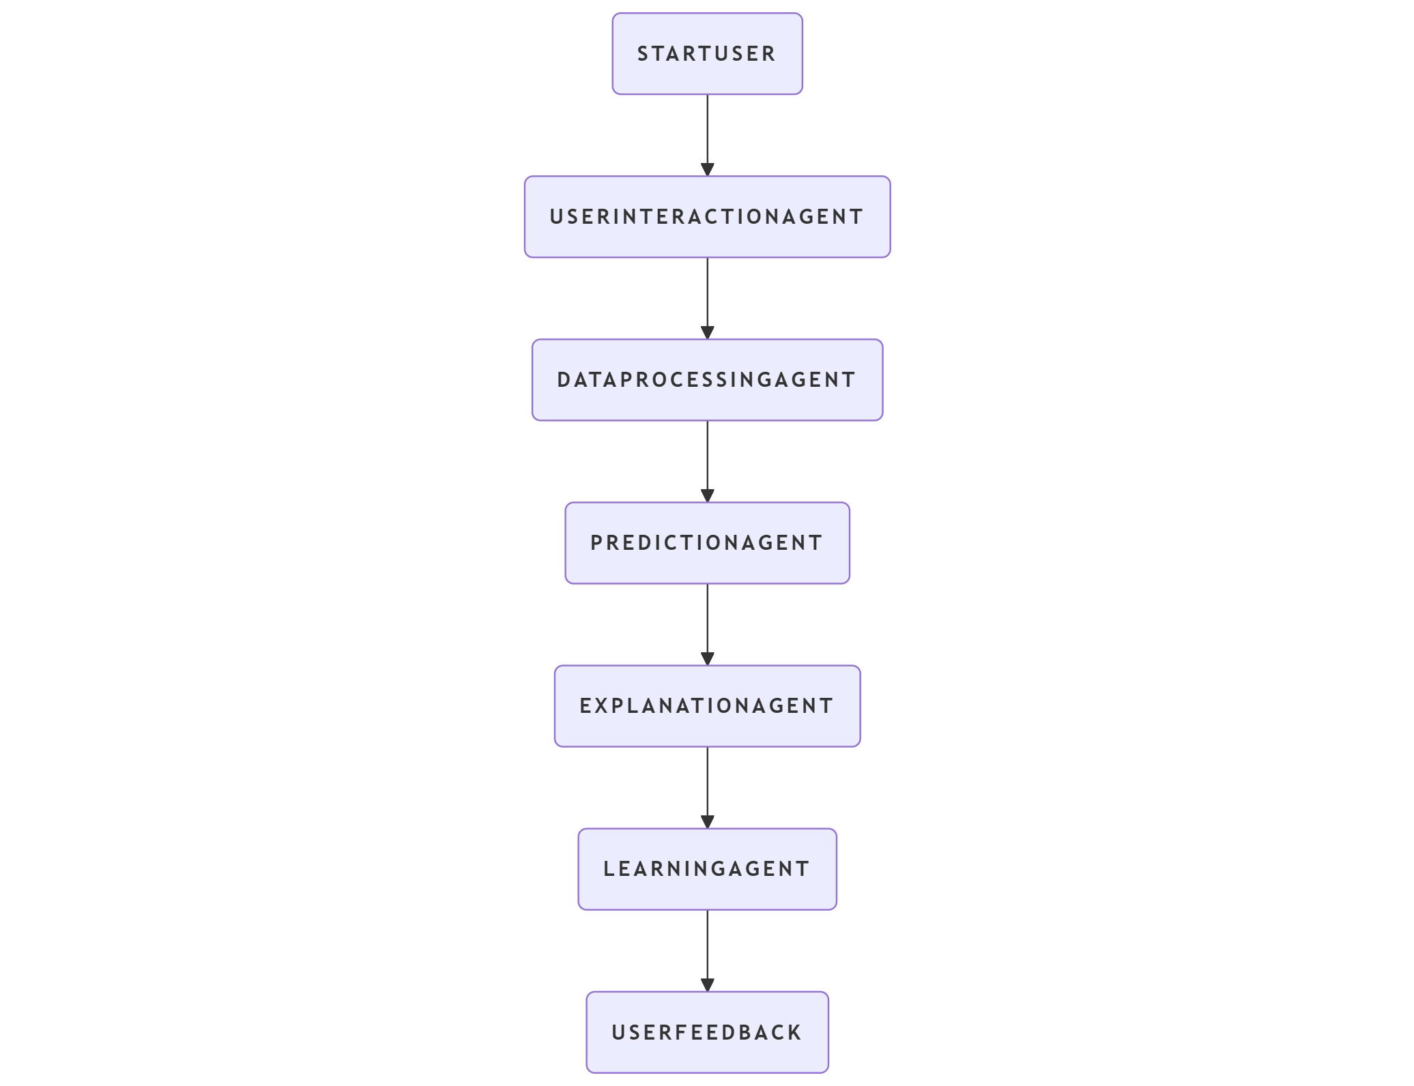
Agentic AI Architecture Used

Slide 8
Agent 1 - User Interaction Agent
Interface between user and AI system.
Collects and validates input data.
Displays prediction results clearly.
Connects users with backend AI modules.

Slide 9
Agent 2 – Data Processing Agent
Cleans and validates patient data.
Checks for missing or invalid values.
Converts data into model-ready format.
Ensures quality for accurate prediction.

Slide 10
Agent 3 – Prediction Agent
Loads trained machine learning model.
Predicts heart disease probability.
Sends output to Explanation Agent.
Core intelligence producing predictions.

Slide 11
Agent 4 – Explanation & Reasoning Agent
Uses SHAP/LIME for interpretability.
Highlights top influencing factors.
Provides medical reasoning.
Explains predictions in simple terms.

Slide 12
Agent 5 – Learning & Recommendation Agent
• Learns from feedback and outcomes.
• Retrains model with new data.
• Generates personalized advice.
• Ensures continuous improvement.

Slide 13
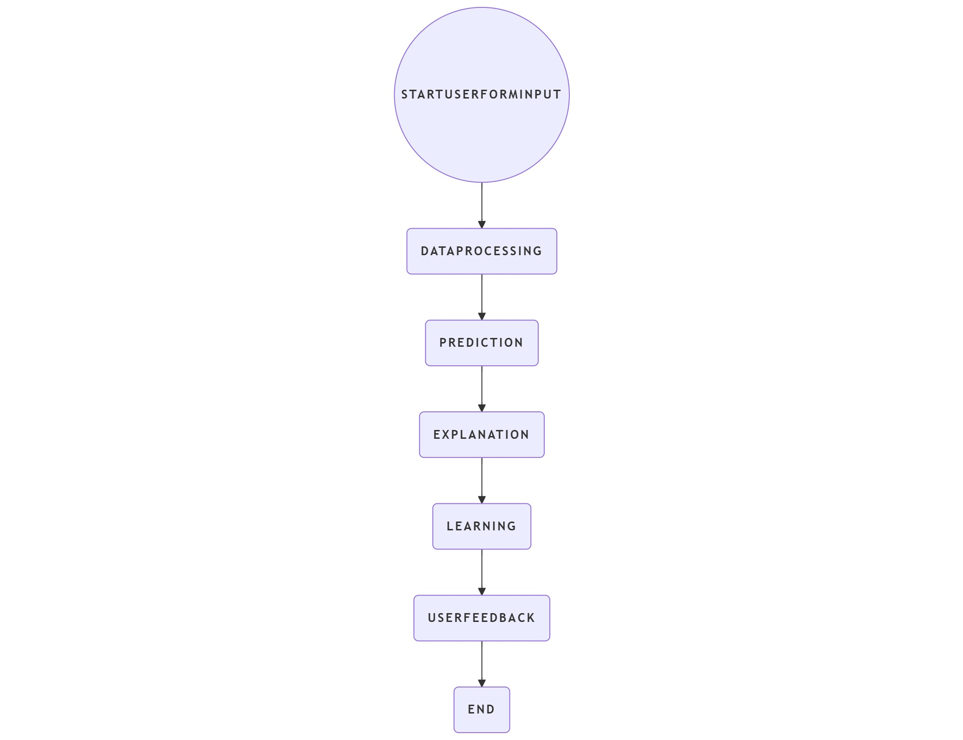
System Workflow

Slide 14
Advantages of Agentic AI Approach
✅ Fully autonomous prediction cycle
✅ Transparent and explainable decisions
✅ Personalized recommendations
✅ Continuous learning
✅ Web-based, user-friendly interface

Slide 15
Conclusion
• Agentic AI enhances automation and interpretability in healthcare.
• Multi-agent system improves prediction accuracy and learning.
• Supports preventive care through smart recommendations.

Slide 16
References
1. V. K. Gnanavel, R. Sukanya, H. Mercy, P. Jayalakshmi and S. Veeramalai, "GUI Base Prediction of Heart Stroke Stages by Finding the Accuracy using Machine Learning Algorithm," 2022 International Conference on Data Science, Agents & Artificial Intelligence (ICDSAAI), Chennai, India, 2022, pp. 1-5, doi: 10.1109/ICDSAAI55433.2022.10028815.
2. M. C. Das et al., "A comparative study of machine learning approaches for heart stroke prediction," 2023 International Conference on Smart Applications, Communications and Networking (SmartNets), Istanbul, Turkiye, 2023, pp. 1-6, doi: 10.1109/SmartNets58706.2023.10216049
3. M. U. Emon, M. S. Keya, T. I. Meghla, M. M. Rahman, M. S. A. Mamun and M. S. Kaiser, "Performance Analysis of Machine Learning Approaches in Stroke Prediction," 2020 4th International Conference on Electronics, Communication and Aerospace Technology (ICECA), Coimbatore, India, 2020, pp. 1464-1469, doi: 10.1109/ICECA49313.2020.9297525.
4. P. Garg, T. Jain, V. Vashishtha, V. Tiwari and A. Kumar, "Heart Stroke Prediction using Machine Learning," 2023 2nd International Conference on Futuristic Technologies (INCOFT), Belagavi, Karnataka, India, 2023, pp. 1-5, doi: 10.1109/INCOFT60753.2023.10425509

Slide 17
Thank You

